Slide 1
ENGINEERING GRAPHICS 1
CLASS 3: PROJECTION OF LINES-2
(SHEET 3)

Slide 2
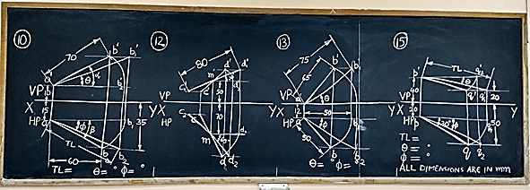

Slide 3
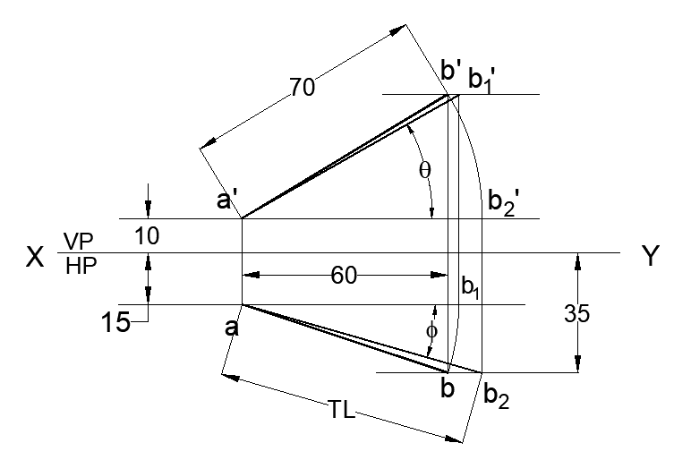
QUESTION BANK: PROJECTION OF LINES - PROBLEM 10
The distance between the end projectors through the end points of a line AB is 60 mm. The end A is 10 mm above HP and 15 mm in front of VP. The end B is 35 mm in front of VP. The line AB appears as 70 mm long in the front view. Draw the projections and determine its true length and the inclinations.
All dimensions are in mm

Slide 4
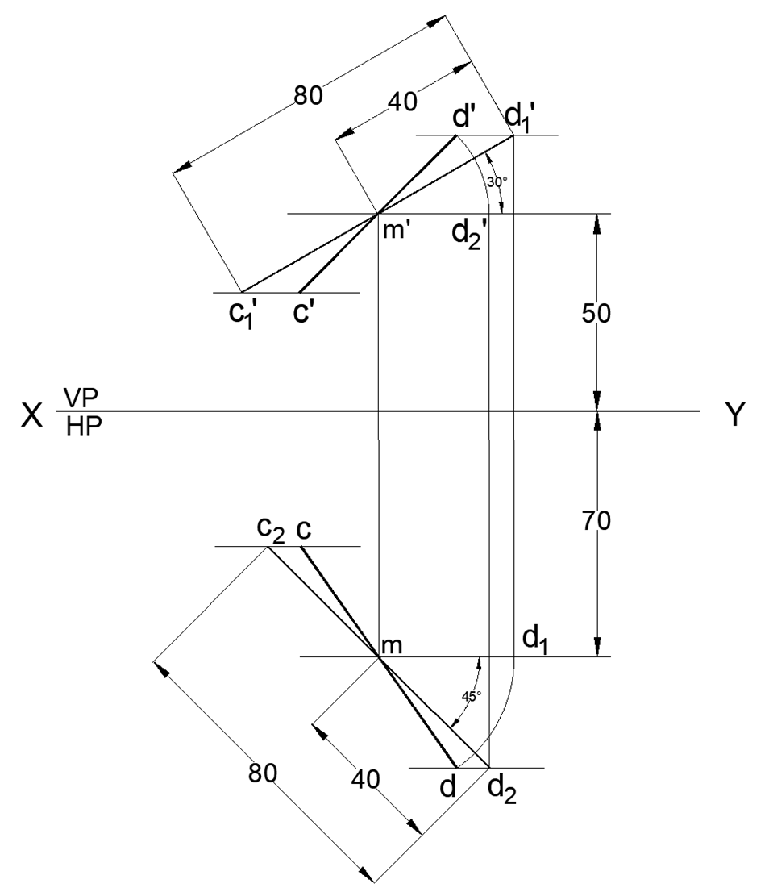
QUESTION BANK: PROJECTION OF LINES - PROBLEM 12
A line CD of length 80 mm is inclined at 30° to HP and 45° to VP. The midpoint M of the line is 50 mm above HP and 70 mm in front of VP. Draw the projections of the line.
All dimensions are in mm

Slide 5
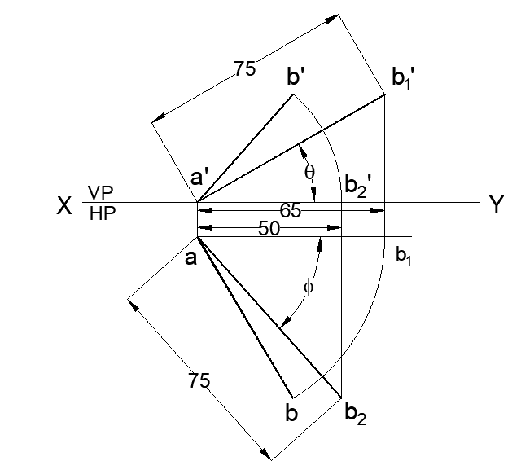
QUESTION BANK: PROJECTION OF LINES - PROBLEM 13
The top view of a 75 mm long line AB measures 65 mm, while the front view is 50 mm. End A is in HP and 12 mm in front of VP. Draw the projections of line AB and determine its inclination with HP & VP.
12
All dimensions are in mm

Slide 6
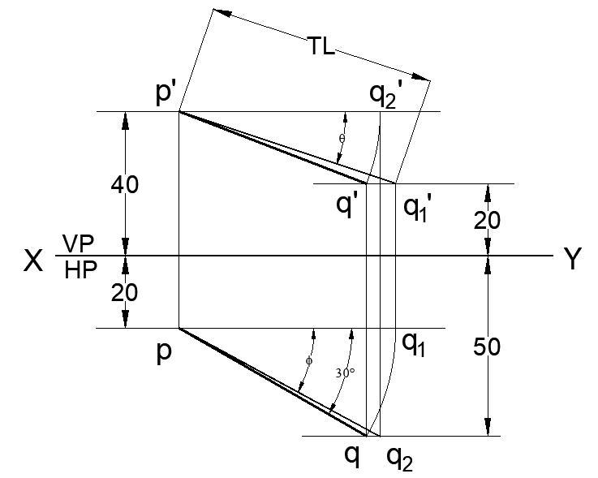
QUESTION BANK: PROJECTION OF LINES - PROBLEM 15
The end P of a line PQ is 40 mm above HP and 20 mm in front of VP. Other end Q is 20 mm above HP and 50 mm in front of VP. The top view of the line is inclined at 30° to XY line. Draw the projections.
All dimensions are in mm

